Slide 1
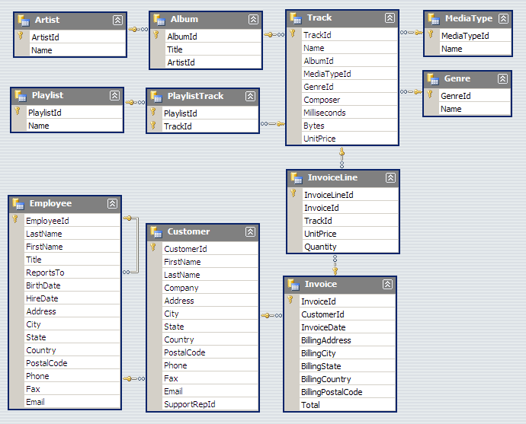
Chinook
DB
Schema

Slide 2
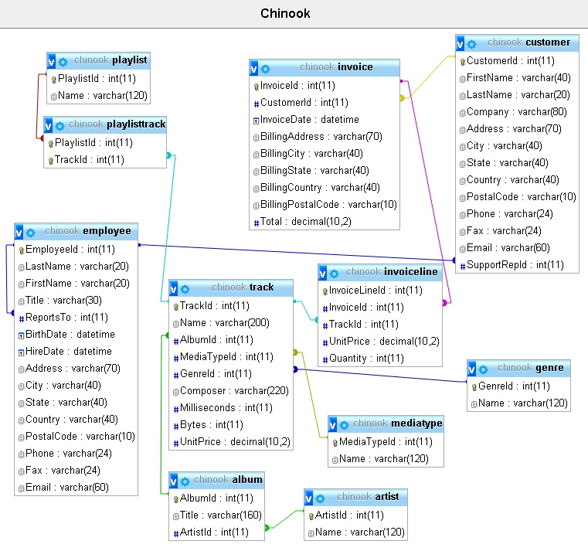
Chinook DB
Extended Schema

